Slide 1
EXOPLANET
EXPLORATION
DATS-6202
MACHINE LEARNING
CHIEMEZIEM OGUAYO
NATE EHAT

Slide 2
ANALYSIS
BACKGROUND

Slide 3
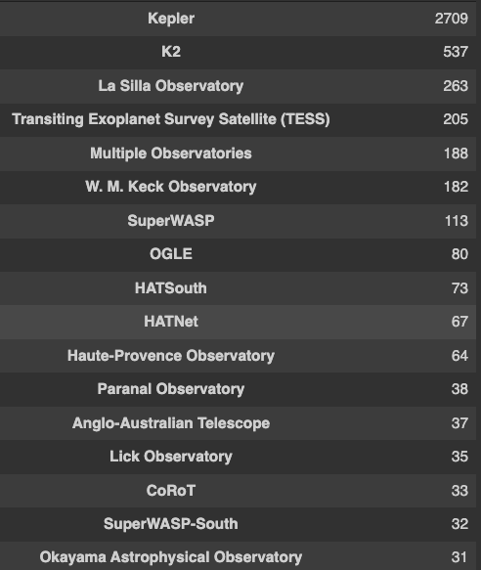
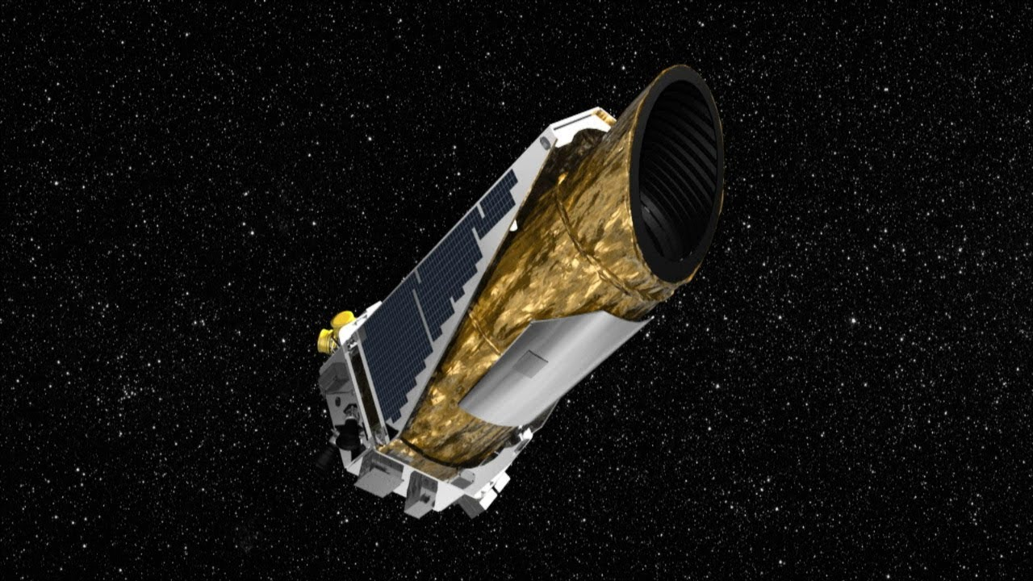
EXOPLANET DISCOVERIES
[TOP OBSERVATORIES]
5,014
CONFIRMED EXOPLANETS
~32,500
PLANETARY SYSTEMS
KEPLER

Slide 4
PRIMARY TELESCOPE / MISSION DATA
Kepler (2009-2018)
First mission search for Earth-sized planets within habitable zones of nearby stars.
K2 (2018-Present)
Continuation of Kepler's exoplanet discoveries, utilizing vast data archives.
TESS (2018-Present) – Transiting Exoplanet Survey Satellite
Surveying the sky to find transiting exoplanets around brightest stars near Earth.
James Webb Space Telescope (2021-Present)
Advanced instrument capabilities; most powerful telescope launched to date.

Slide 5
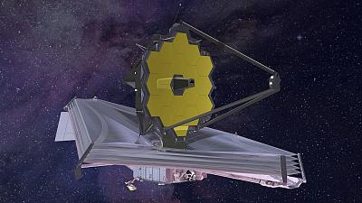
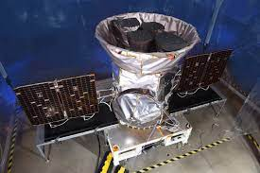
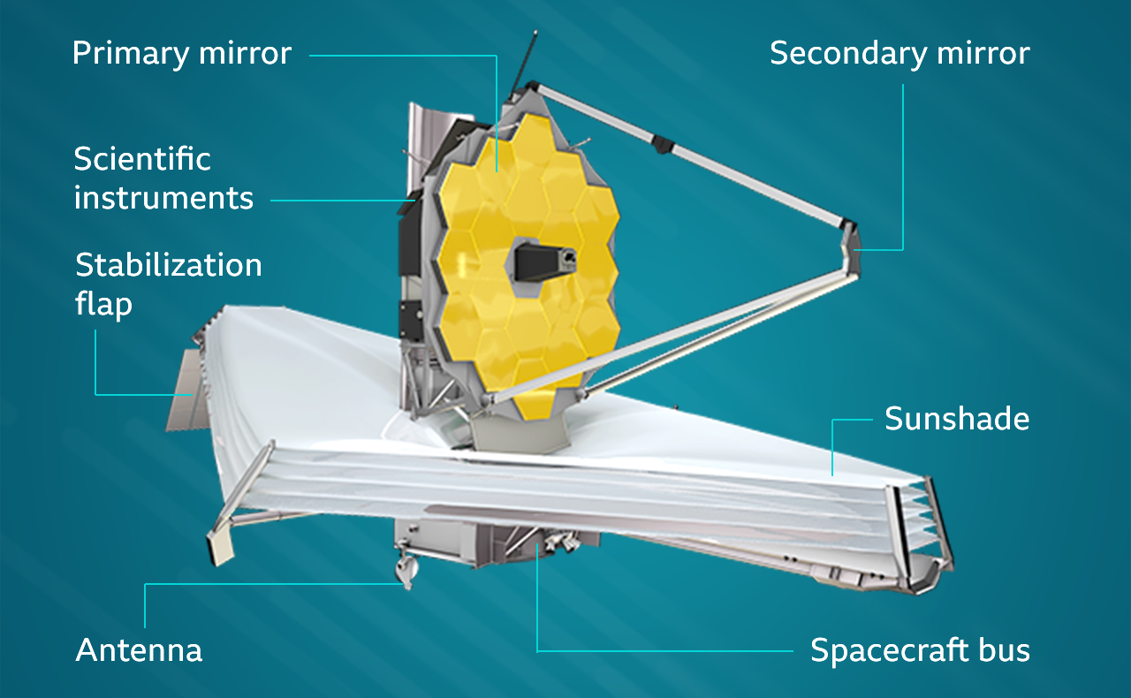
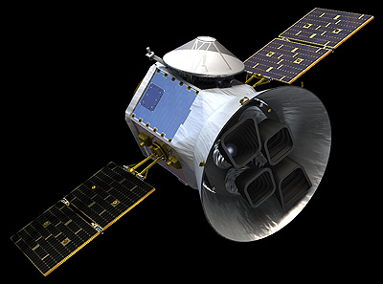
PRIMARY TELESCOPE / MISSION DATA
JAMES WEBB SPACE TELESCOPE TESS [TRANSITING EXOPLANET SURVEY SATELLITE]

Slide 6
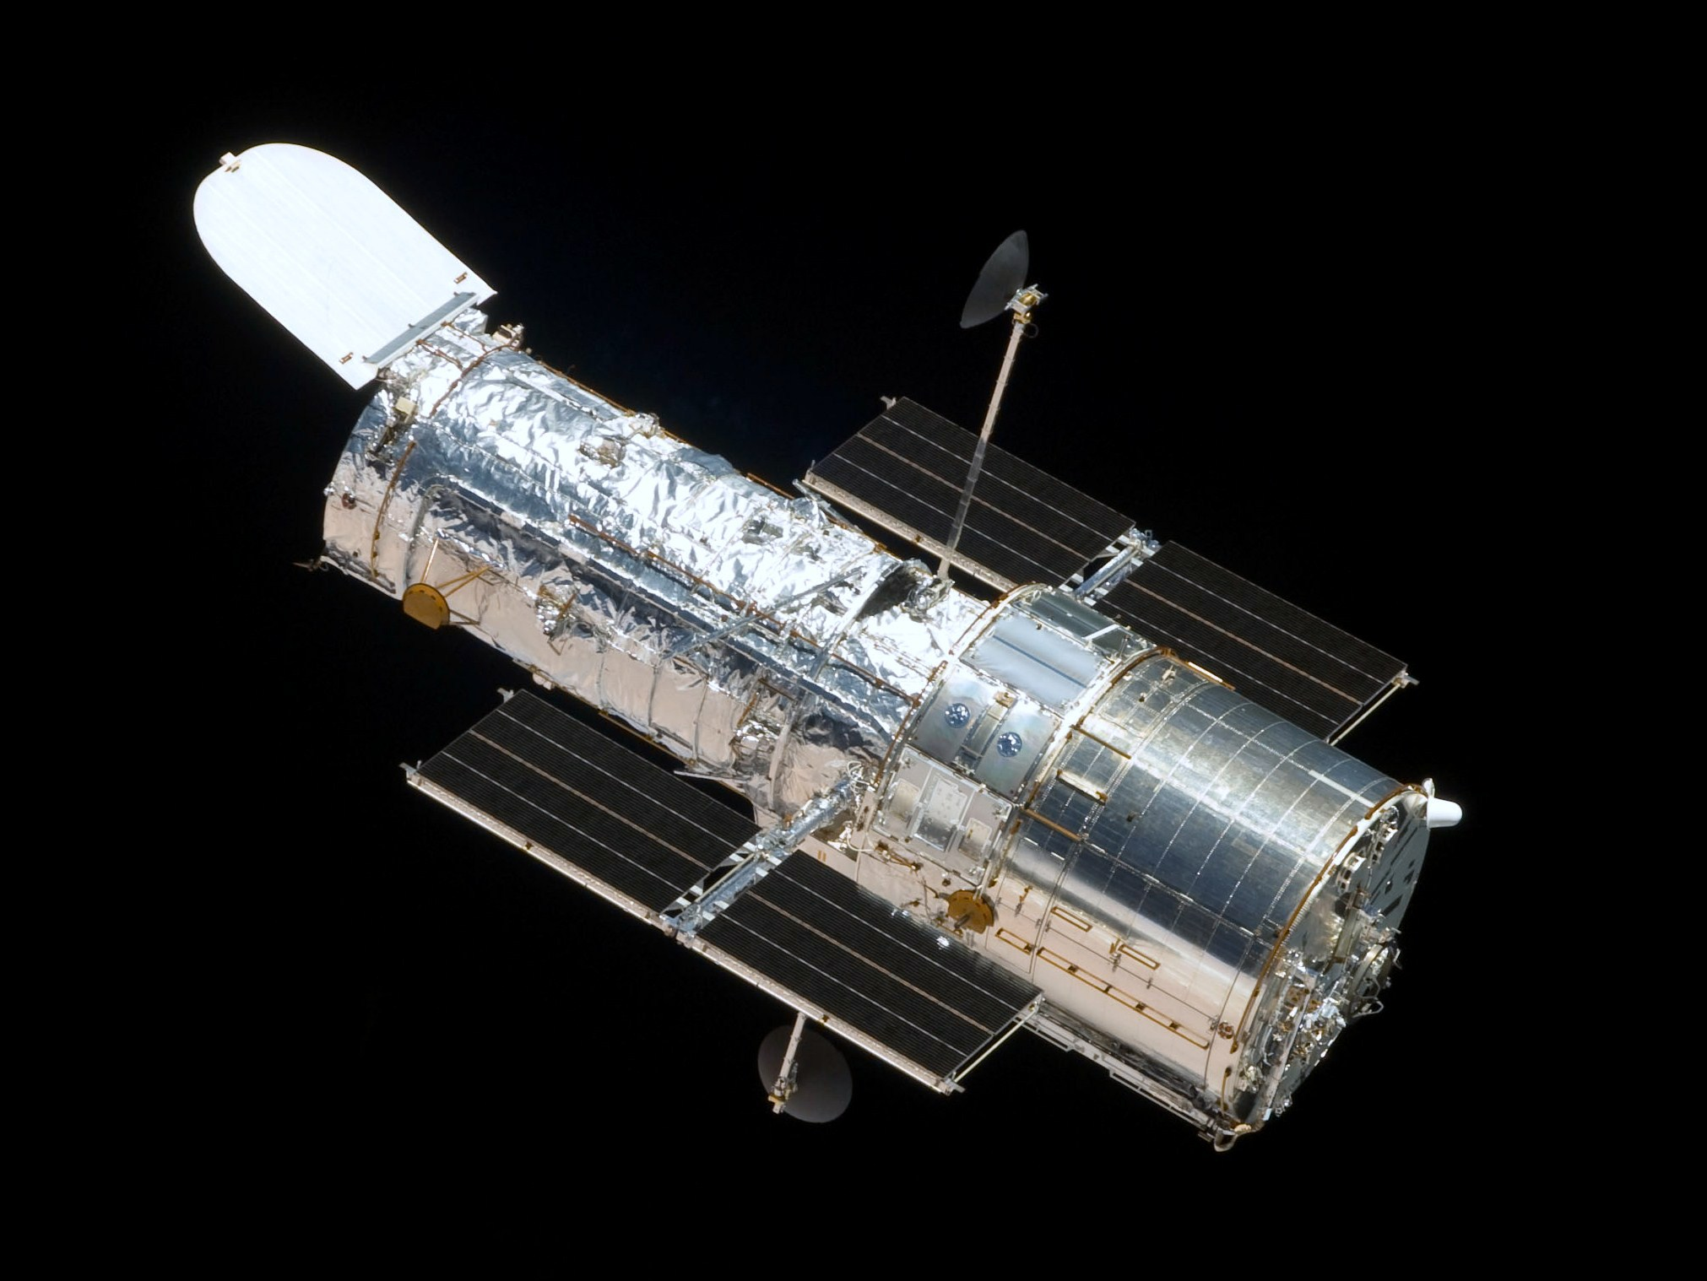
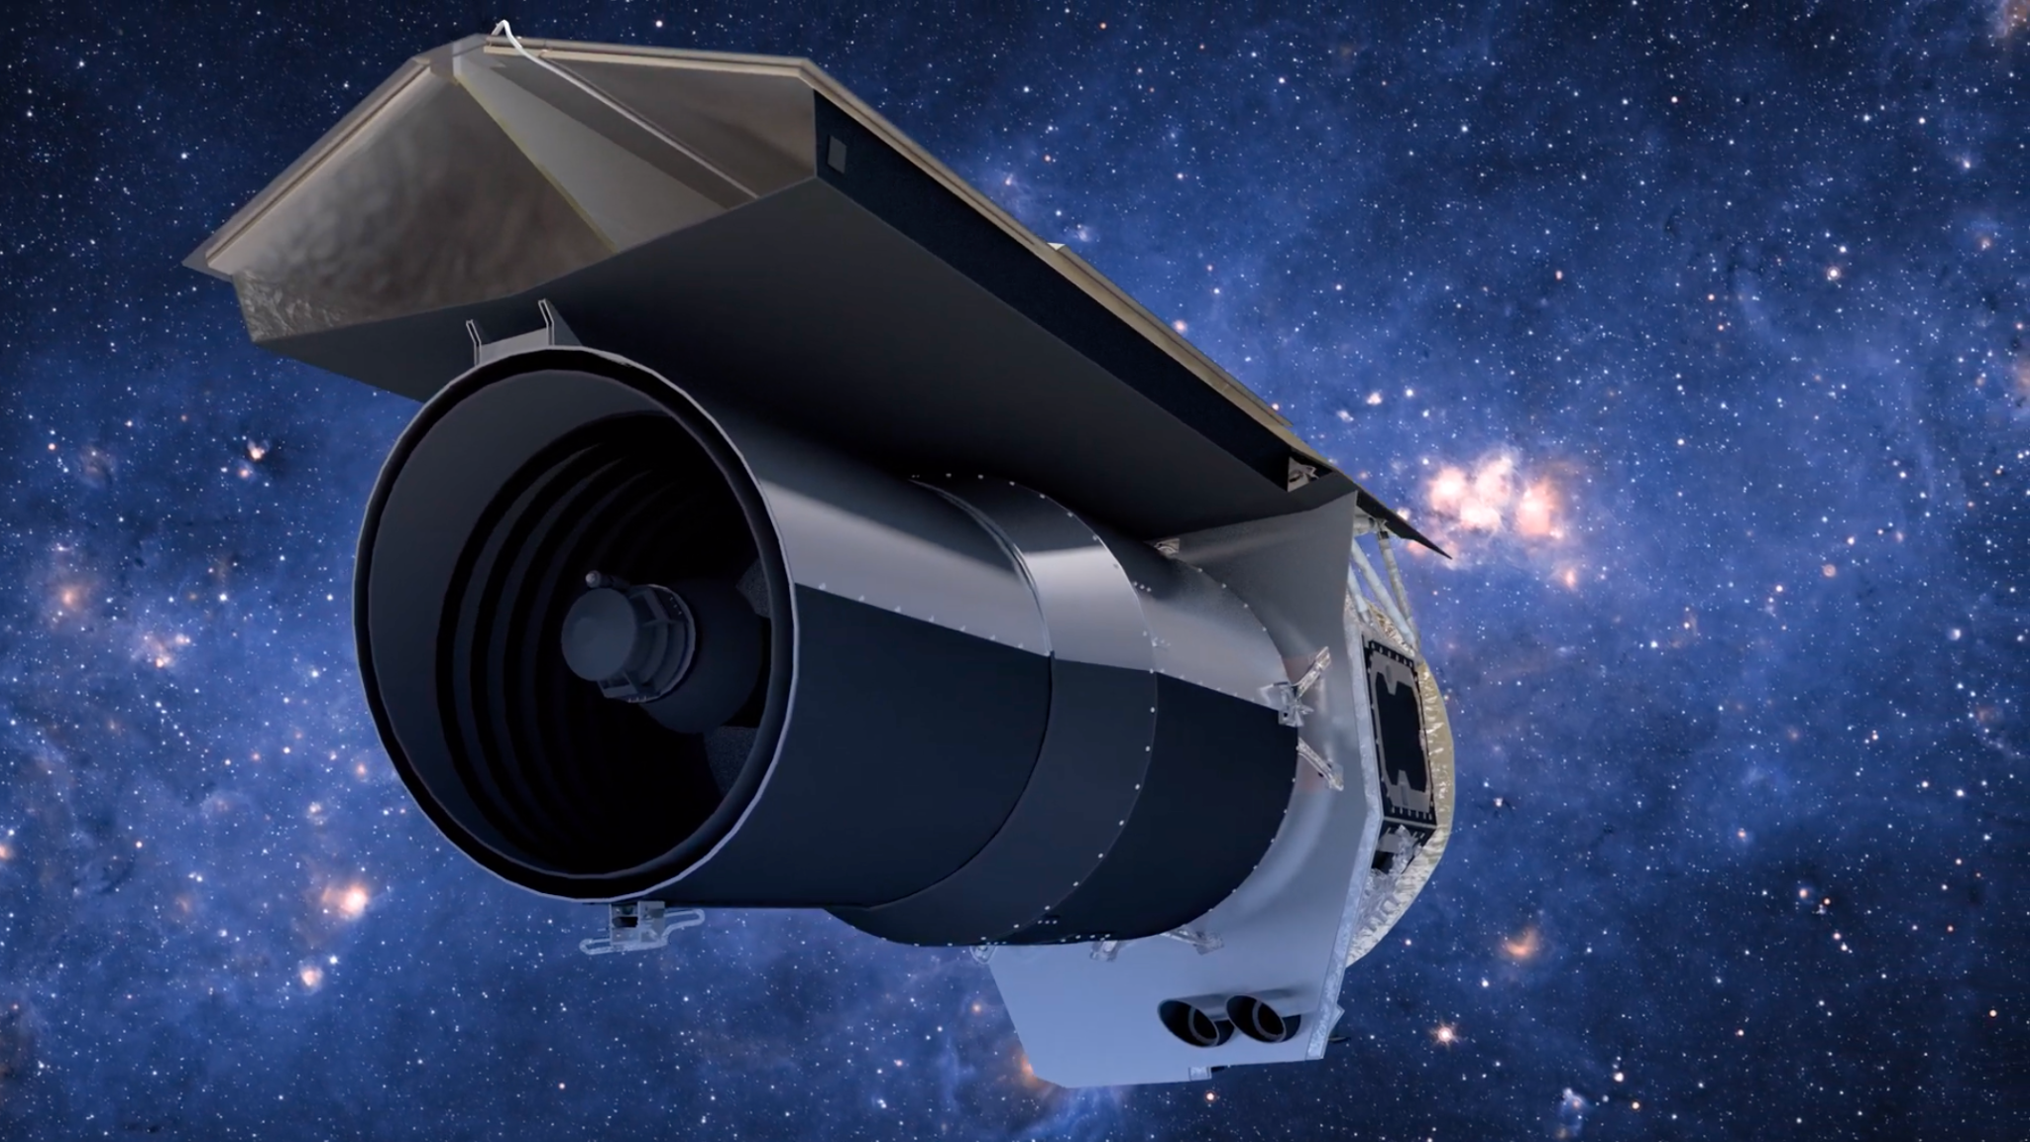
SPECTROGRAPHY
TRANSIT / EMISSION
Hubble Space Telescope [NASA]
Wide-Field Camera
Spitzer Space Telescope [NASA]
Infrared Array Camera (IRAC)
Infrared Spectrograph (IRS)
Hale Telescope [CalTech]
Wide-Field Infrared Camera (WIRC)
HADES – HArps-n red Dwarf Exoplanet Survey

Slide 7
DIRECT IMAGING / MICROLENSING
DIRECT IMAGING
NRM, NACO, NICS, IRCS, SPHERE, SIMON
MICRO-LENSING
Various Telescopic Instruments
PLANNED MISSIONS
Nancy Grace Roman Space Telescope [2027]
ARIEL - European Space Agency [2029]

Slide 8
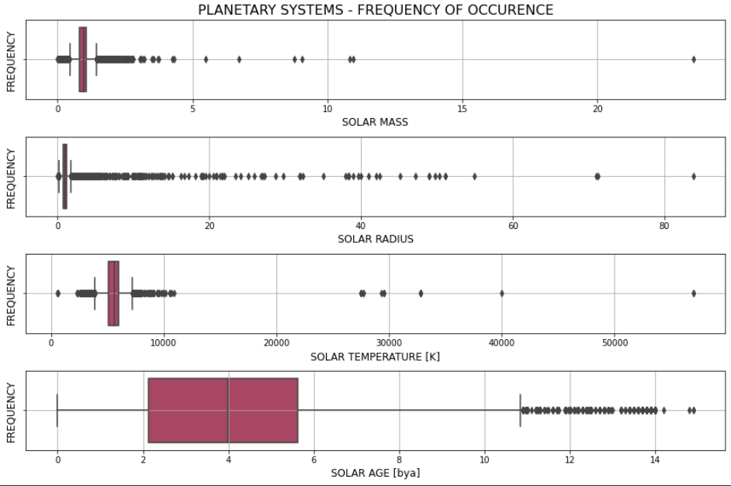
PLANETARY SYSTEMS

Slide 9
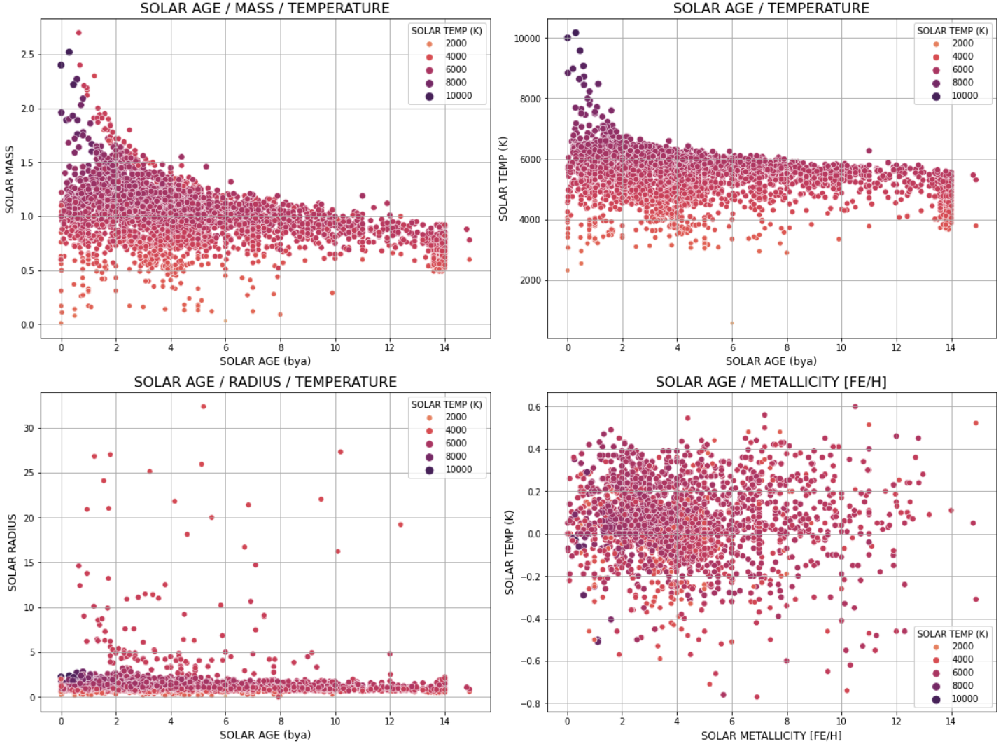
STAR SYSTEMS
Notes:
SOLAR AGE —- MASS /// TEMP /// RADIUS /// METTALICITY [FE/H] spectrographic measurement

Slide 10
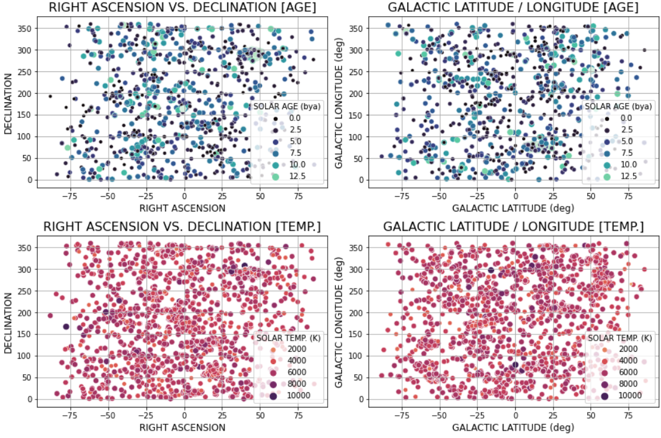
GALACTIC LOCATION
Notes:
Right Acension - east–west coordinate by which the position of a celestial body is ordinarily measured;
DECLINATION - the angular distance of a point north or south of the celestial equator.

Slide 11
IDEOLOGY /
METHODOLOGY

Slide 12
MODELING PIPELINE
Scraping / Mining — CalTech Exoplanet Archive database primary source of data for extraction and exploration
Pre-Processing — Handling uncommon features, handling identifiers, scaling the data, imputing null values
Model Predictions — Building model and assessing models’ ability to predict exoplanet confirmation
Model Evaluation — Evaluating best models performance

Slide 13
MODEL

Slide 14
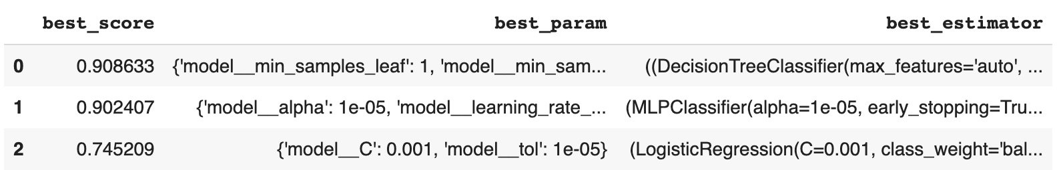
MODEL RESULTS

Slide 15

MODEL EVALUATION

Slide 16
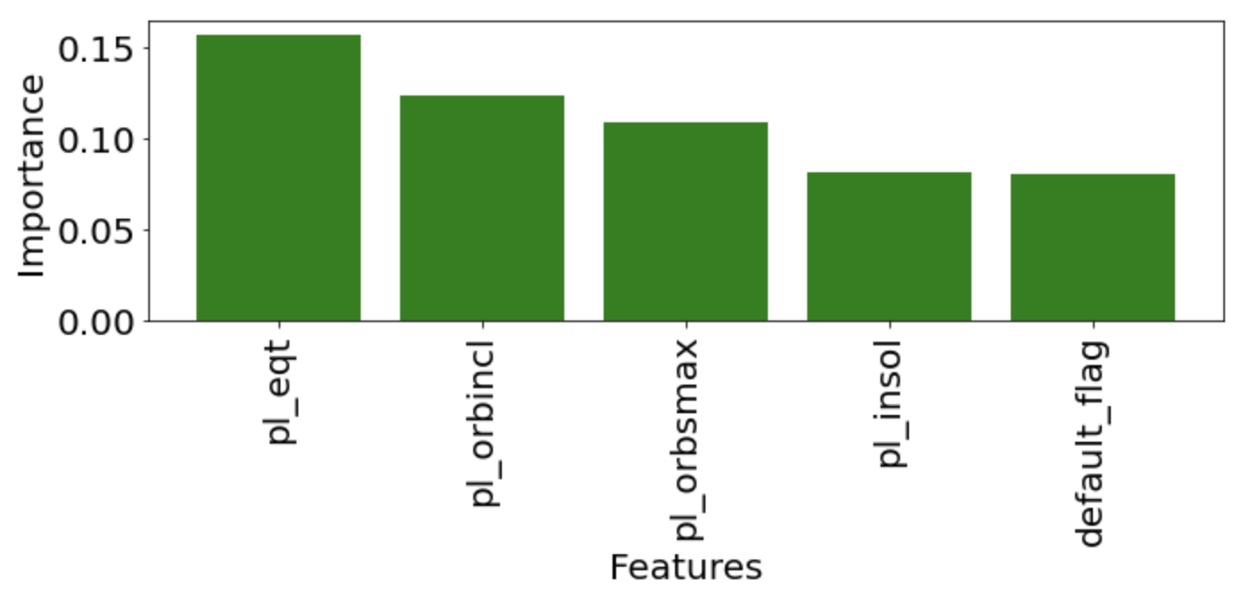
Model Evaluation
Equilibrium Temperature, Inclination, Orbit Semi-Major axis, Insolation Flux, Default Parameter Set

Slide 17
CONCLUSIONS

Slide 18
CONCLUSIONS / TAKEAWAYS
DATA MINING:
High accessibility of exoplanet data – yet many gaps
MODELING PIPELINE:
Classification is most logical application of ML as applied to data set under investigation, though image recognition of galaxies may offer greater insights in the future
FUTURE RESEARCH:
Supplemental NASA data (James Webb Telescope / TESS)
Image recognition - opportunity to deploy neural network architecture, utilizing multi-lens / light telescopic imagery

Slide 19
APPENDIX

Slide 20
SOURCES / CITATIONS
CalTech Exoplanet Archive
https://exoplanetarchive.ipac.caltech.edu/index.html
https://exoplanetarchive.ipac.caltech.edu/cgi-bin/TblView/nph-tblView?app=ExoTbls&config=PS
https://exoplanetarchive.ipac.caltech.edu/docs/counts_detail.html
NASA Publications
https://exoplanets.nasa.gov/news/1702/cosmic-milestone-nasa-confirms-5000-exoplanets/
https://www.scientificamerican.com/article/5-000-exoplanets-nasa-confirms-a-cosmic-milestone/

Slide 21
NOTES /
REFERENCE

Slide 22

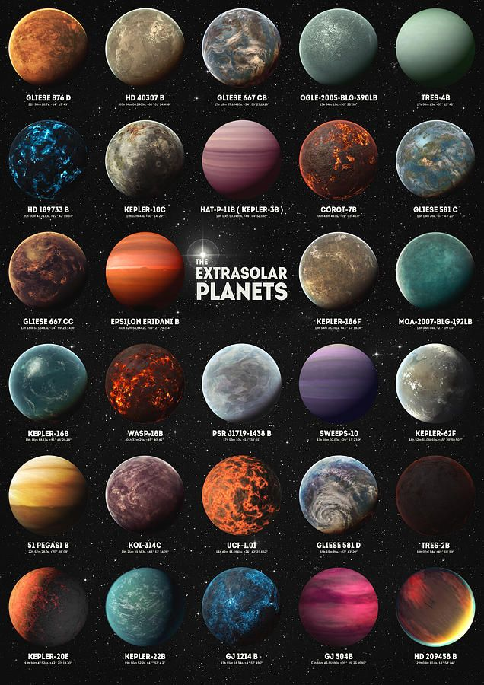
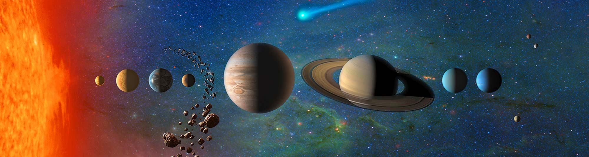
PHOTO BANK
https://i.pinimg.com/originals/99/46/c4/9946c4622e1c43439ef8b6268d7f7d85.jpg
https://www.google.com/search?q=exoplanets+galaxy+background+map+slides&tbm=isch&ved=2ahUKEwiBtoSQr673AhUCPN8KHaxeBKgQ2-cCegQIABAA&oq=exoplanets+galaxy+background+map+slides&gs_lcp=CgNpbWcQAzoHCCMQ7wMQJ1CkAljpFGCkF2gBcAB4AIABc4gB4gWSAQM3LjKYAQCgAQGqAQtnd3Mtd2l6LWltZ8ABAQ&sclient=img&ei=XyJmYsGKLIL4_AasvZHACg&bih=944&biw=1920#:~:text=Exoplanets%20by%20Zapista%20OU%20%7C%20Space%20and%20...,pinterest.com

